Slide 1
Distilled LLM-based Skill Extraction from LinkedIn Job Descriptions
Ashwin Shankar
Jaskirat Benipal
Jinhong Liu
Rakesh Kumar
Sai Charan
GPT-5uperpowered Sea Urchins

Slide 2
Previous Works

Slide 3
Skill Extraction from Job Postings Using Pre-trained Language Models
Proposes a method for extracting job skills using Weak Supervision
Zhang et al.
(2022)

Slide 4
Retrieving Skills from Job Descriptions: A Language Model Based Extreme Multi-label Classification Framework
language model-based approach for extracting skills from job descriptions using extreme multi-label classification
Bhola et al.
(2020)

Slide 5
Occupational skills extraction with FinBERT
Method for extracting occupational skills from financial job postings using the FinBERT language model
Mariia Chernova
(2020)

Slide 6
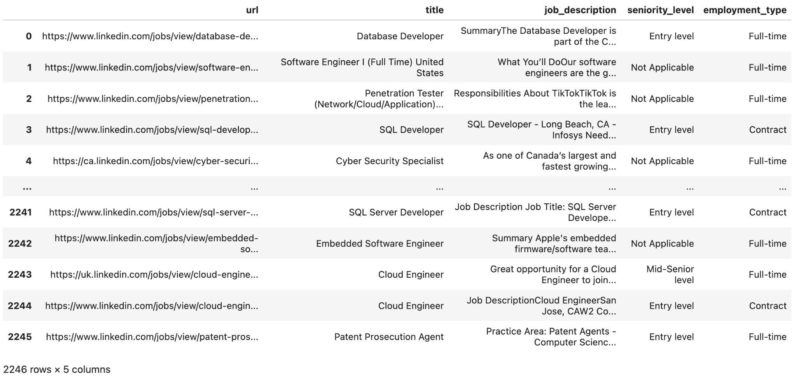
Data
Data from previous 523 project:

Slide 7
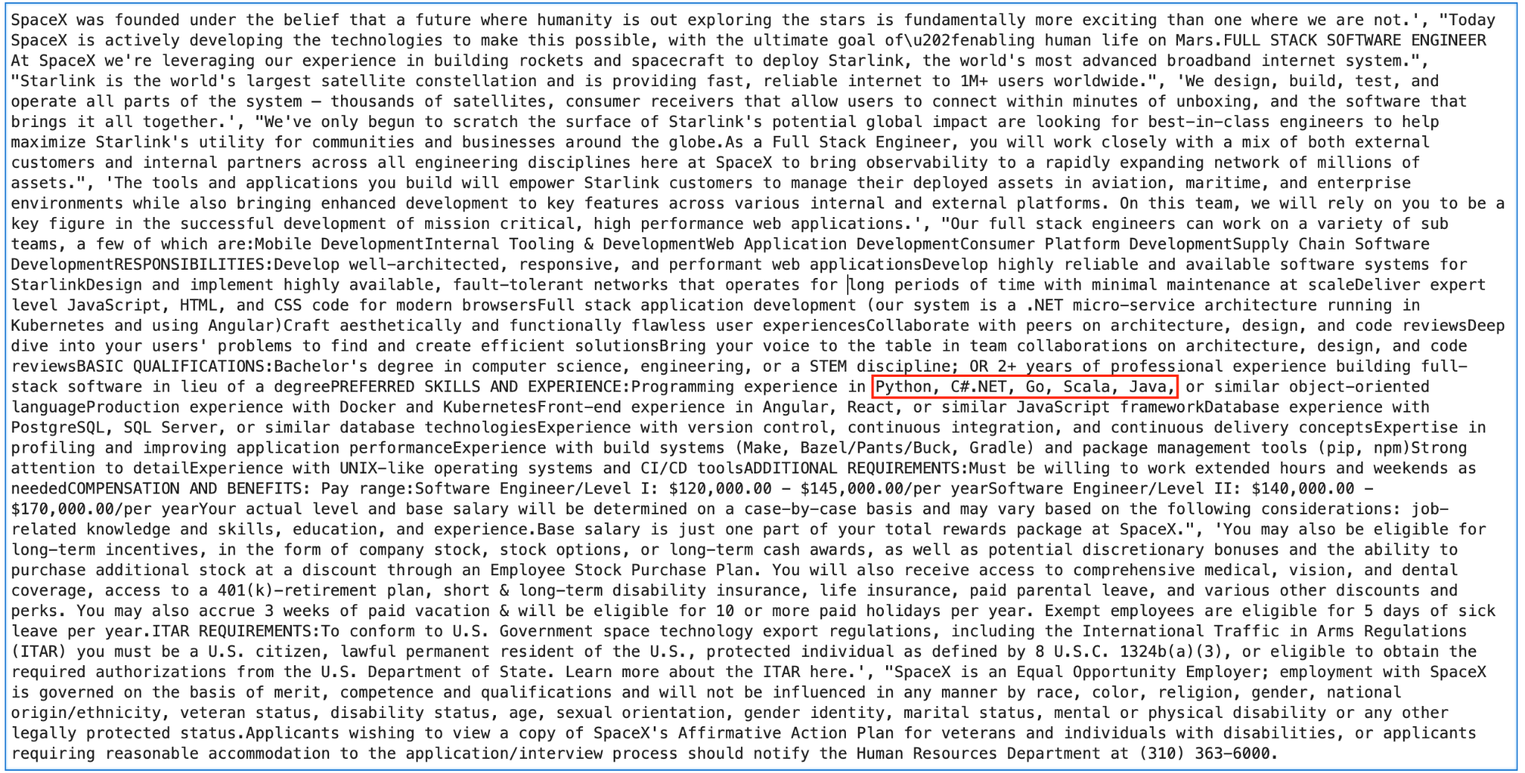
Sample Job Description

Slide 8
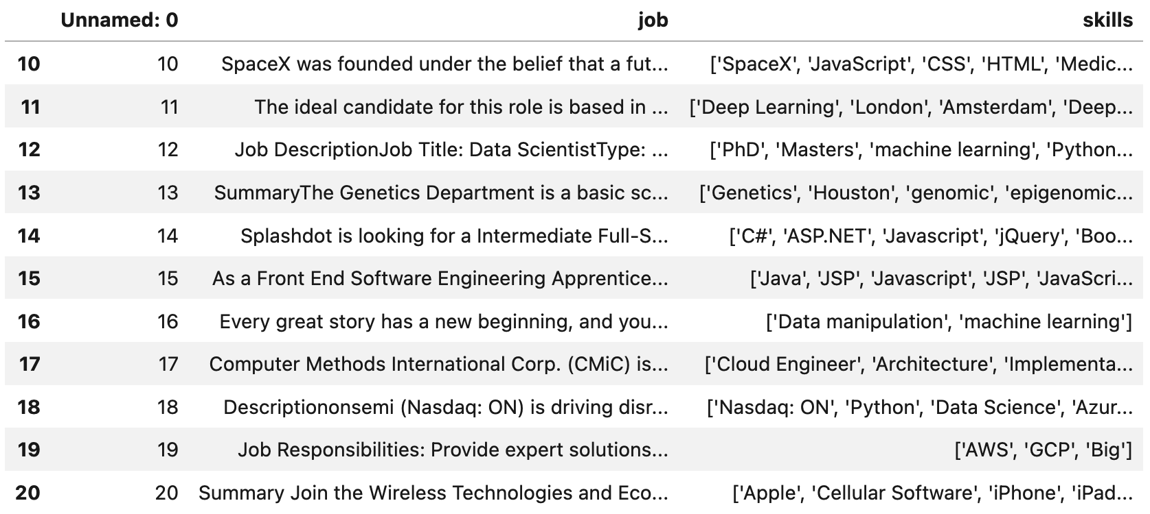
Data
Job skills extracted by GPT-3 text-curie-001 model

Slide 9
Data cleaning
Around 3750 unique skills extracted by GPT-3 model.
Each team member filtered valid skills from around 750 skills.
[“full-time”, “Java”, “Python”, “C++”, “Pandas / Pytorch /”, “100”, “$”]
[“Java”, “Python”, “C++”, “Pandas”, “Pytorch”]
Totally 1933 unique skills remaining after filtering.

Slide 10
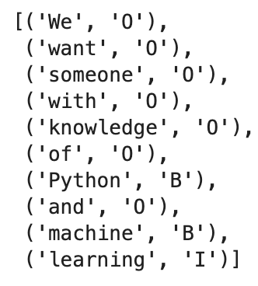
Methods (models used)
Training tasks
LSTM (bidirectional)
BERT
DistilBERT
RoBERTa
FlanT5
1. Token classification (BIO tagging)
(We used this task for LSTM and BERT)
Available data format
Input: We want someone with knowledge of Python and machine learning.
Target: Python, machine learning
2. Seq2seq
(We used this training method for FlanT5)
Input: We want someone with knowledge of Python and machine learning
output: Python, machine learning

Slide 11
Result
Model | Precision | Recall | F1 Score
LSTM | 0.411 | 0.489 | 0.447
RoBERTa | 0.452 | 0.317 | 0.373
Flan-t5-base | 0.39 | 0.28 | 0.32
BERT | 0.229 | 0.176 | 0.199
DistilBERT | 0.221 | 0.128 | 0.162
We used Precision, Recall, and F1 score to measure how accurately the model can identify relevant skills from job descriptions. This helps us to see how well the model performs and identify areas for improvement.
We have identified a potential issue in the tokenization for the BERT-based models. We believe this could be the cause of the unexpectedly poor performance of the BERT-based models compared to the LSTM (though this may not be the case!)

Slide 12
Future scope of this project involves:
Categorizing the extracted skills into different categories such as programming languages, tools, frameworks, and other relevant categories.
Expanding the scope beyond recruitment industry to other industries and domains, including healthcare, technology, law, and more. For example, extracting legal terms from law documents can help law firms in their search for legal talent.
Improving the accuracy of the model by fine-tuning and incorporating additional language models versions such as BERT large, RoBERTa, and GPT-3, and exploring other advanced NLP techniques.
Creating an interactive user interface to allow users to search and browse extracted skills and explore job opportunities based on their skillset, experience, and preferences.
Future scope
The current project has focused on extracting skills from job descriptions, but the future scope is vast and can benefit the recruitment industry in many ways. Due to time availability, the current project is limited to extracting skills from job descriptions only.

Slide 13
Thank You!

